Slide 1
Used Cars Prediction Model Presentation
By: Zavion Henderson

Slide 2
Intro: Why Predicting Car Prices Matters
Objective: Develop a machine learning model to predict the price of used cars.
Models Compared: Linear Regression, Decision Tree, and Random Forest.
Key Evaluation Metrics: R² (accuracy) and RMSE (error).
Best Performing Model: Random Forest with highest accuracy and lowest error.
Business Impact: Improved pricing strategy for buyers and sellers.

Slide 3
The Challenge: Understanding What Drives Price
Accurate pricing is crucial for a competitive used car market.
Buyers want fair pricing; sellers want to maximize profits.
Key variables affecting pricing need to be identified.
A well-calibrated model helps businesses make strategic decisions.
Machine learning can provide data-driven insights.

Slide 4
What Factors Matter Most? (EDA)
Lineplot: Shows feature relationships between Year & Price
Histogram of Price: Identifies skewness and distribution.
Scatterplots: Price vs Significant Features ('Engine' & 'Power')

Slide 5
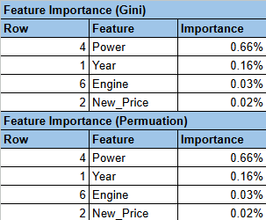
Feature Importance: Random Forests
Strong and Consistent Feature Importance:
The 'Power' feature has the most significant effect on the accuracy of our pricing model because of its dynamic relationship with other features
Both methods which operate on different principles, are converging on the same conclusion, strengthening the confidence in these features' importance.
'Power', 'Year', and 'Engine' are shown with a feature importance score of 85%

Slide 6
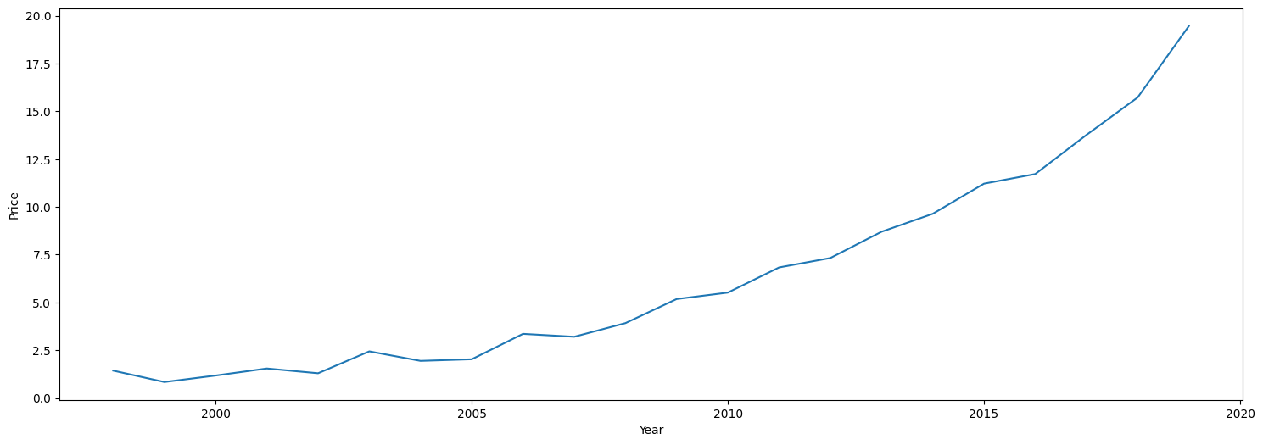
Year vs Price (bivariate analysis)

Slide 7
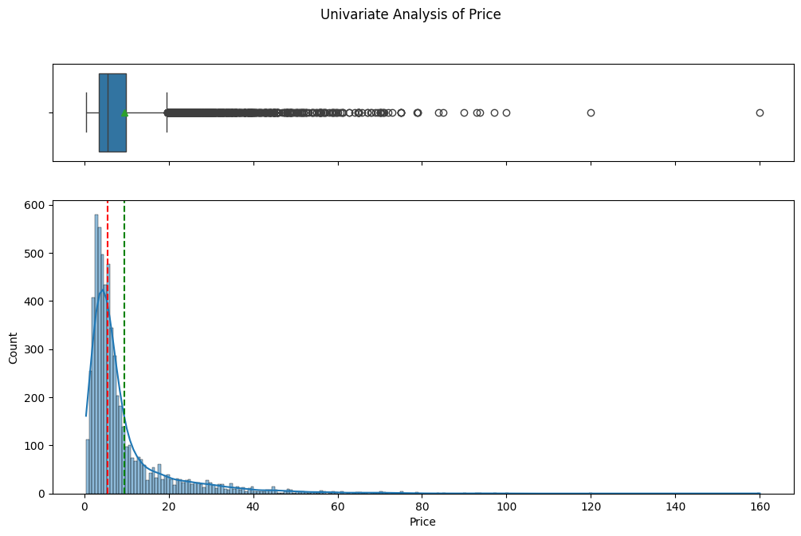
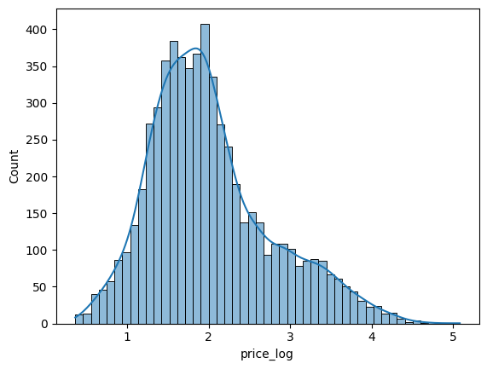
Log transformation (Price)

Slide 8
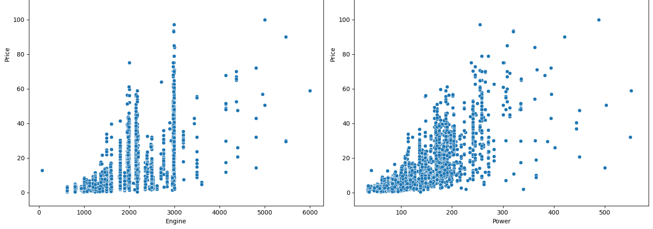
Feature Importance: Random Forests

Slide 9

Which Model Predicts Price Best?
Linear Regression:
Struggles with non-linearity and complex relationships.
Decision Trees:
Prone to overfitting, less generalization.
Random Forest (Best Model):
Handles non-linearity, reduces overfitting, best generalization.

Slide 10
Why Random Forests is the Best Model?
Highest accuracy with lowest measurement of error.
Captures non-linear relationships effectively.
Reduces overfitting through averaging multiple trees.
Feature Importance Analysis: Identifies key factors influencing price.

Slide 11
How This Model Helps the Industry
Ensures competitive pricing—avoids undervaluing or overpricing cars.
Provides fair and transparent pricing, reducing negotiation uncertainty.
Helps maximize profits while ensuring fair and competitive pricing
Can be used in loan approvals and financing decisions.

Slide 12
Next Steps: Scaling & Future Improvements
Further fine-tune Random Forest to reduce errors
Potentially, improve pricing accuracy by incorporating real time market trends
Develop a real time pricing API to allows dealerships and buyers to use it instantly

